Slide 1
Deduction of Subjective Remarks to Statistical Equivalence by Sentiment Analysis
Abhishek Rattihalli (800959105)
Rakesh Harish (800984018)
Sanju K H (800953525)
Sujal T V (800969246)
Venkatesh Bonageri (800964302)
Vikas Deshpande (800964852)

Slide 2
Contents
Goal
Motivation
Introduction
Data Set
Why Python
Used Python Constructs
Python Libraries
Implemented Techniques
Results/Comparison
Future Scope

Slide 3
Goal
The goal of the project is to predict the rating of a product based on reviews, so that a user can decide whether to buy the product or not just looking at ratings instead of reading all the reviews.
The aim of this project is to predict the star rating of a user’s comment about a product on a scale of 1 to 5
For the implementation, we will be using Amazon Fine Food Review Dataset

Slide 4
Motivation
The motivation for doing this project was primarily from the paper/research activity, Predicting Star Ratings of Movie Review Comments, steered by three Stanford PhD students

Slide 5
Introduction
This project is aimed manifesting Python’s features and analysing its components, constructs, and features
This work aims at textual analysis of subjective/sentimental remarks and infer their statistical equivalence, like rating, for example
Sentiment analysis is one of the most frequent, interesting applications of text analytics

Slide 6
Data Set
We have considered the Amazon product reviews and remarks made by its users
This data set was obtained from Kaggle
The dataset consists of about 568,454 reviews.
The project can be used to any dataset which involves user reviews and can predict its ratings.

Slide 7
Why Python?
Python offers a rich set of libraries, specifically developed for problems in machine learning, data analytics, and artificial intelligence domains
Python is multi paradigm and supports object-oriented, procedural, and functional programming styles
Python has simple syntax, readability, usability, and maintainability
Dynamically typed and flexible, with code that is less verbose

Slide 8
Pros of Python
Python is easy to read, use and maintain.
Extremely popular in academia, creating a large talent pool.
Simple syntax and readability
Dynamically typed and flexible, with code that is less verbose.
Python is multi paradigm and supports OO, procedural, and functional programming styles

Slide 9
Cons of Python
Because it is an interpreted language, it is often many times slower than compiled languages
Python is present on many server and desktop platforms, but it is weak in mobile computing and browsers
Because the language is dynamically typed, it requires more testing and has errors that only show up at runtime
If the libraries are imported, it takes a lot of time to load them before it can be up and running, as in this project

Slide 10
Used Python Constructs
Data abstraction
Array list, dictionary
Data frames
Classes and objects
Control abstraction
if, if–else, nested if–else
for
while, do while

Slide 11
Python Libraries
Pandas for file utilities
Scikit Learn for machine learning techniques
Natural Language Toolkit (NLTK) for sentiment analysis
Matplotlib for graphical visualisation

Slide 12
Implemented Techniques
Decision Tree Classification
Neural Networks
Support Vector Machines
Random Forest Classification
k Nearest Neighbours
Gradient Boosting Classifier

Slide 13
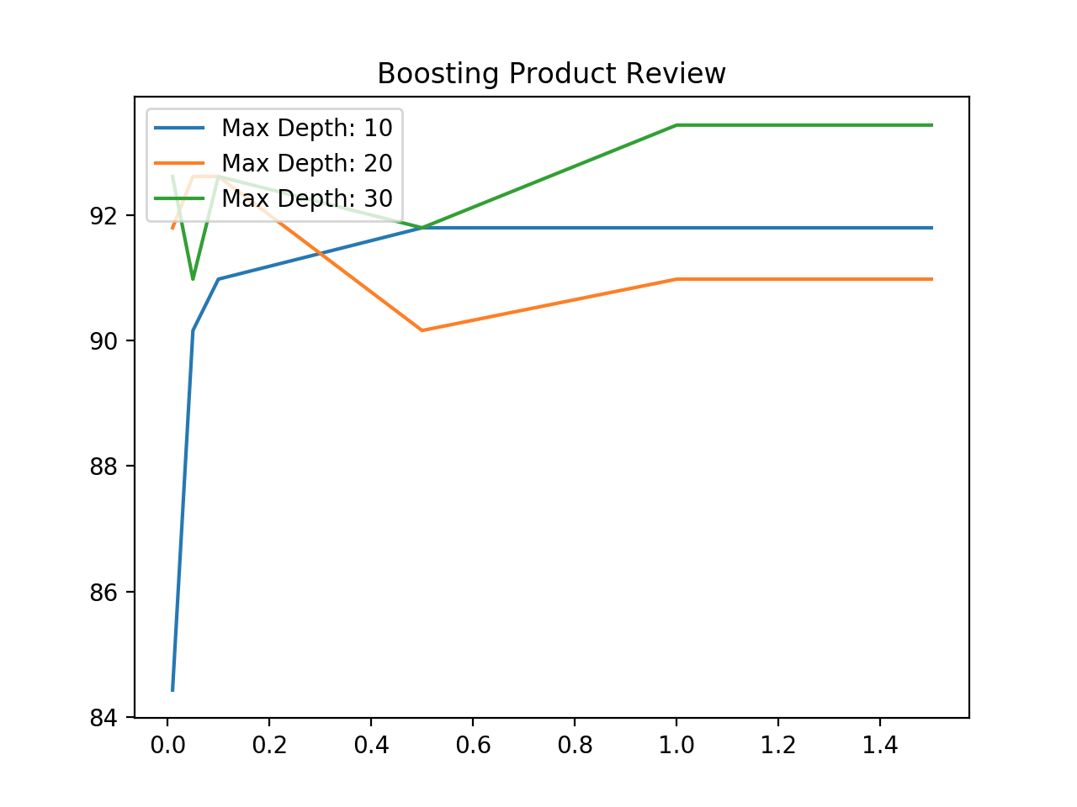
Results/Comparison

Slide 14
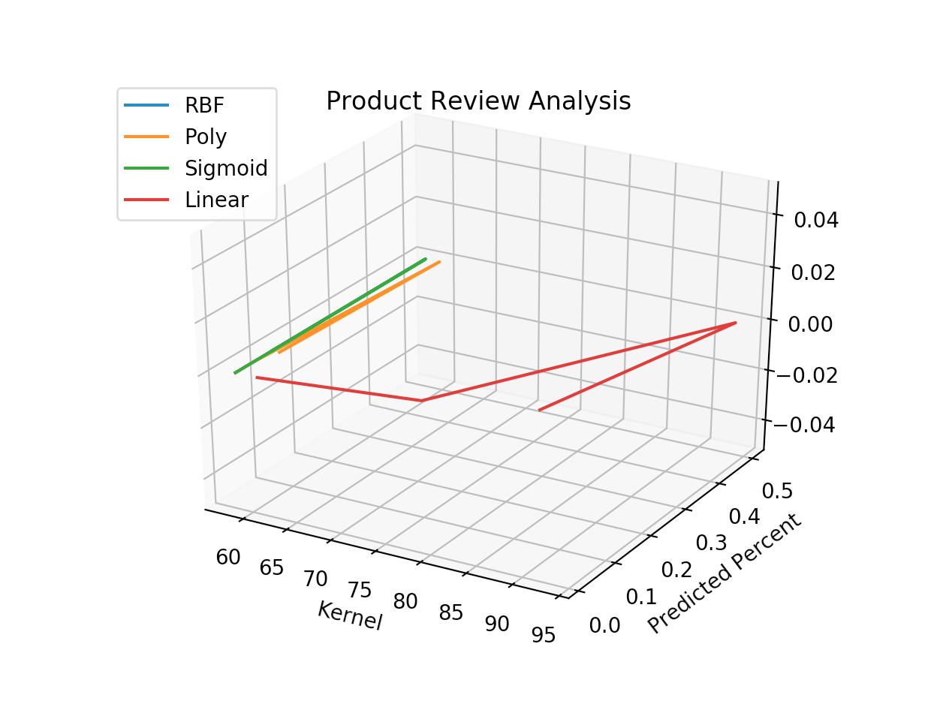
Results/Comparison

Slide 15
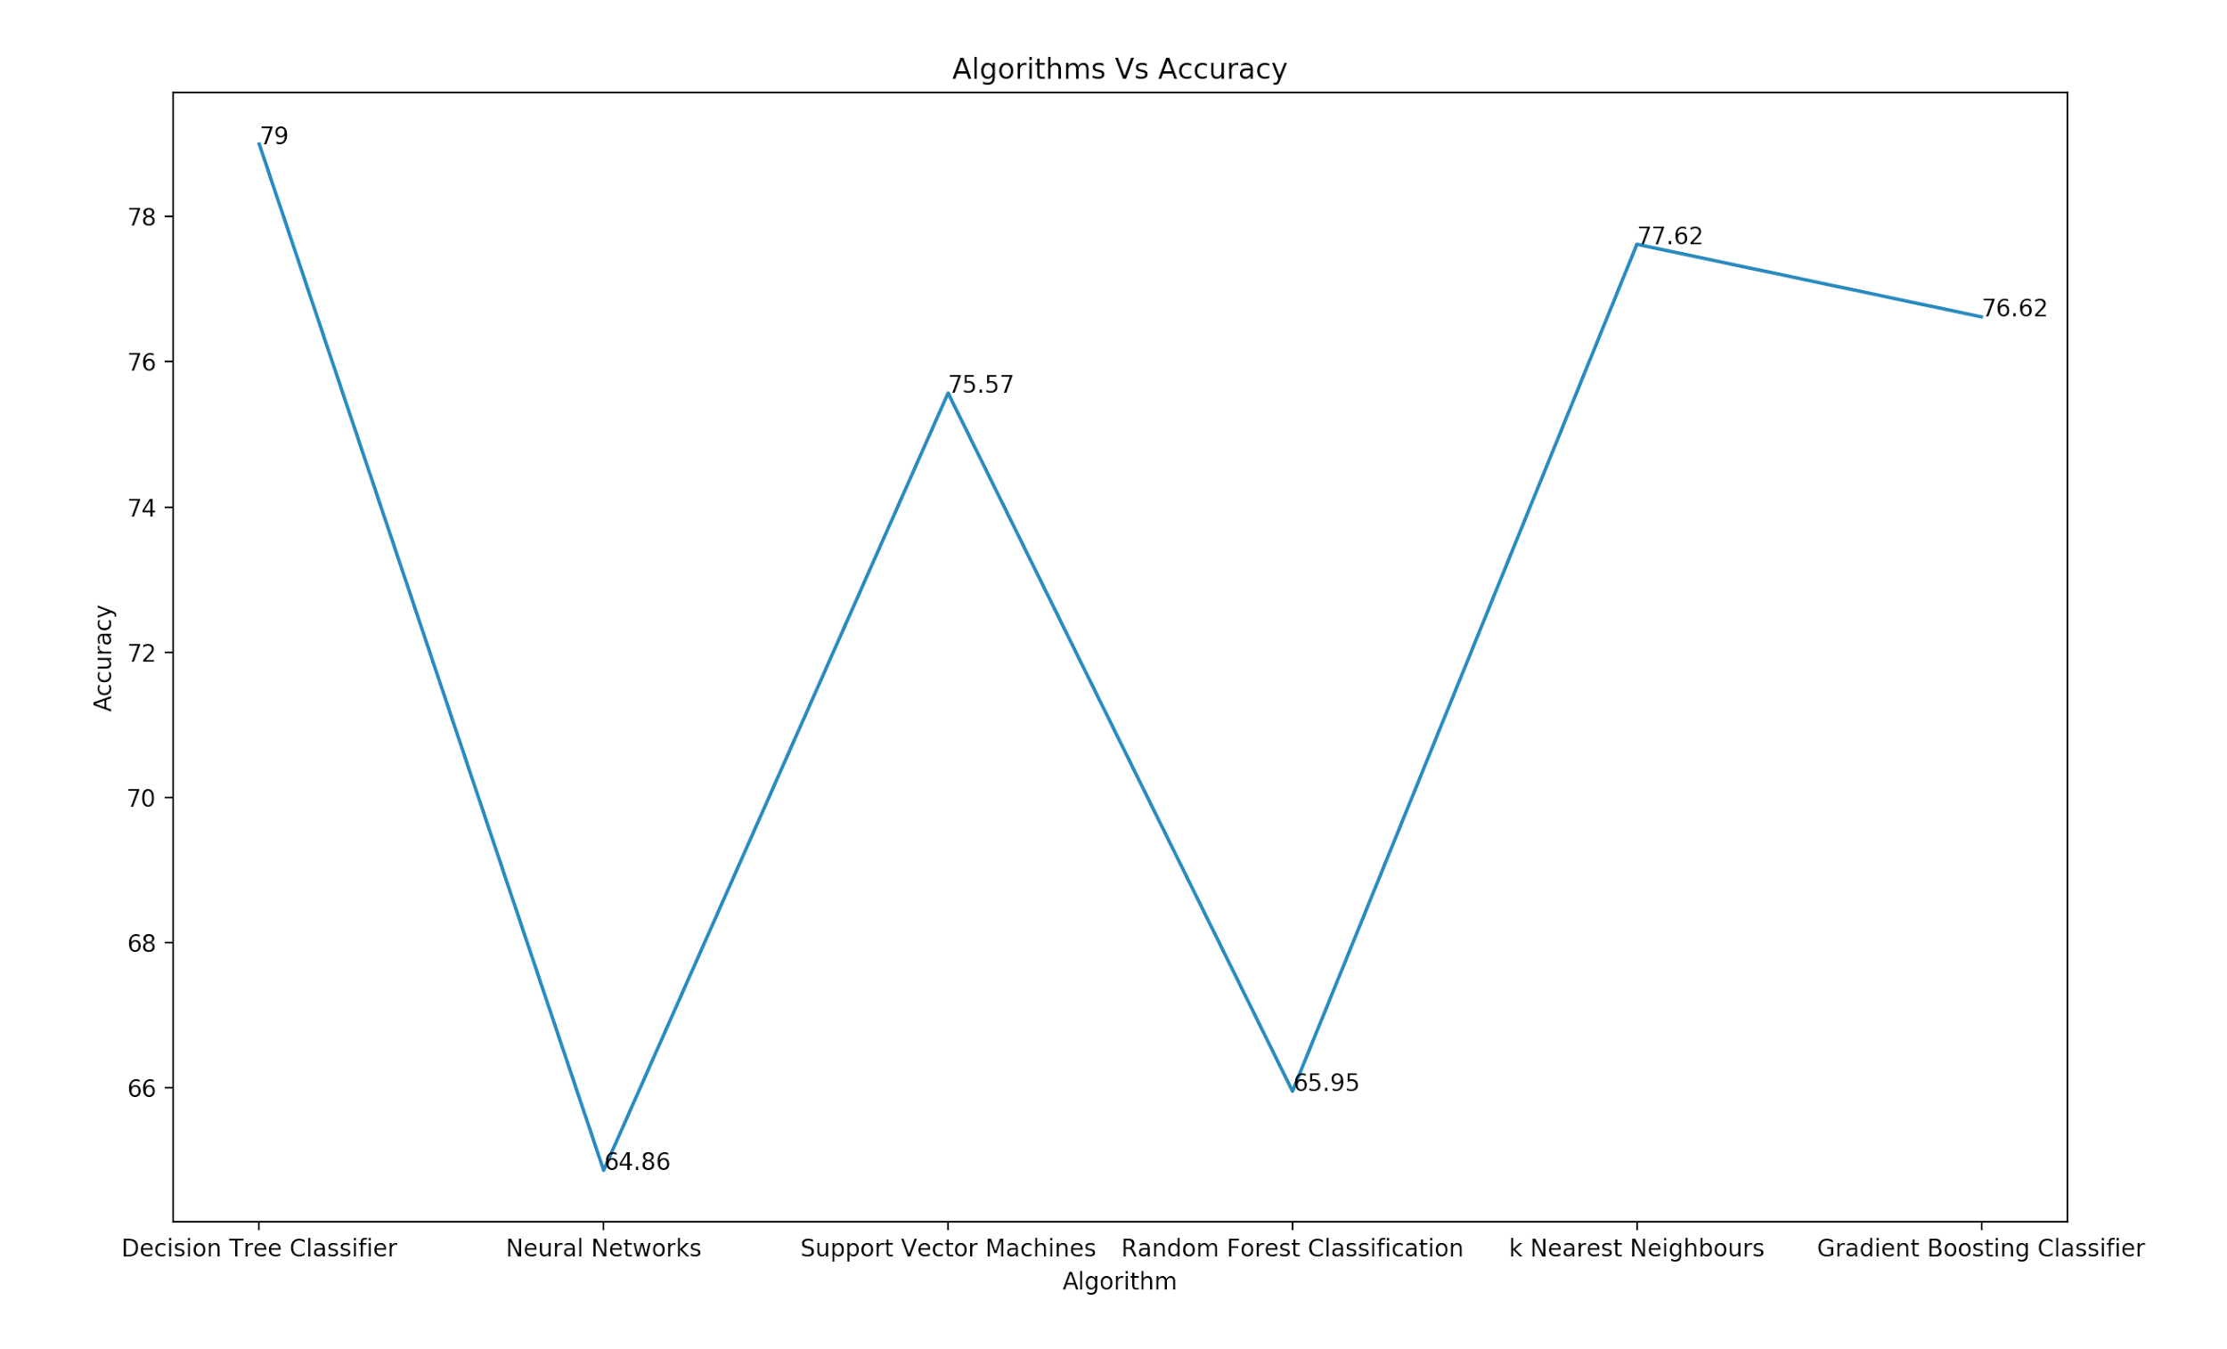
Results/Comparison

Slide 16
Future Scope
Python has robust libraries for graphical user interface
TK Learn, WX Python, Sugar are some of the GUI libraries
This project may be extended to feature graphical user interface to interactively accepts reviews and predict rating in real time

Slide 17
References
https://www.kaggle.com/snap/amazon-fine-food-reviews
http://cs229.stanford.edu/proj2011/MehtaPhilipScaria-Predicting%20Star%20Ratings%20from%20Movie%20Review%20Comments.pdf
http://marcobonzanini.com/

Slide 18
THANK YOU

